Slide 1
A-SIA 2.0
Brandenburg Jonas Duskanich Markus Duskanich Michael Dohnalek Raphael Meindl Tobias

Slide 2
Table of Content
1
2
Mission
Prototyping
3
4
Current Status
Future

Slide 3
1
Mission

Slide 4
About the Project
Create new software inspired by the social impulse analysis
Full stack application
First semester plan was to create prototypes and user stories

Slide 5
Projects Requirements
Create social impulse analysis node networks for different projects and teams
Design the frontend with Angular
Outsource resource heavy computation to a server-side application with ASP.NET C#
Use a graph database with Neo4J

Slide 6
2
Prototyping

Slide 7
Frontend

Slide 8
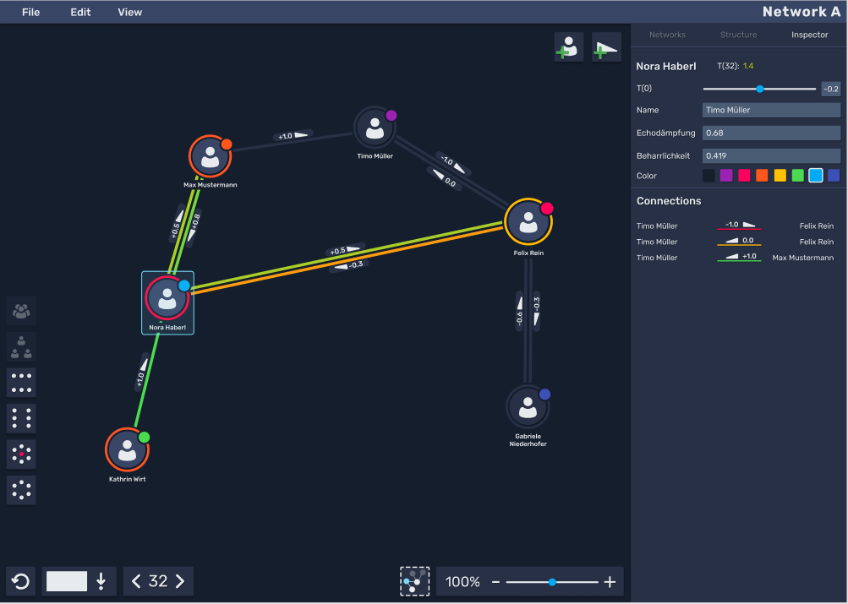
Frontend Prototype

Slide 9
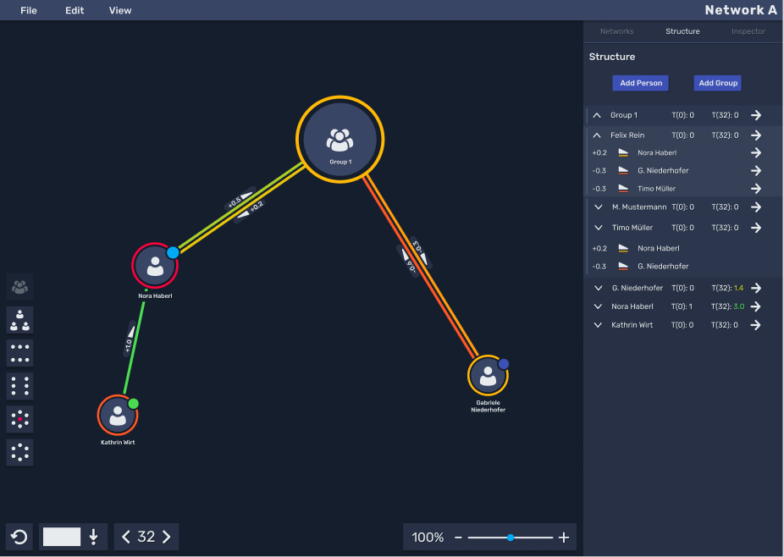
Frontend Prototype

Slide 10
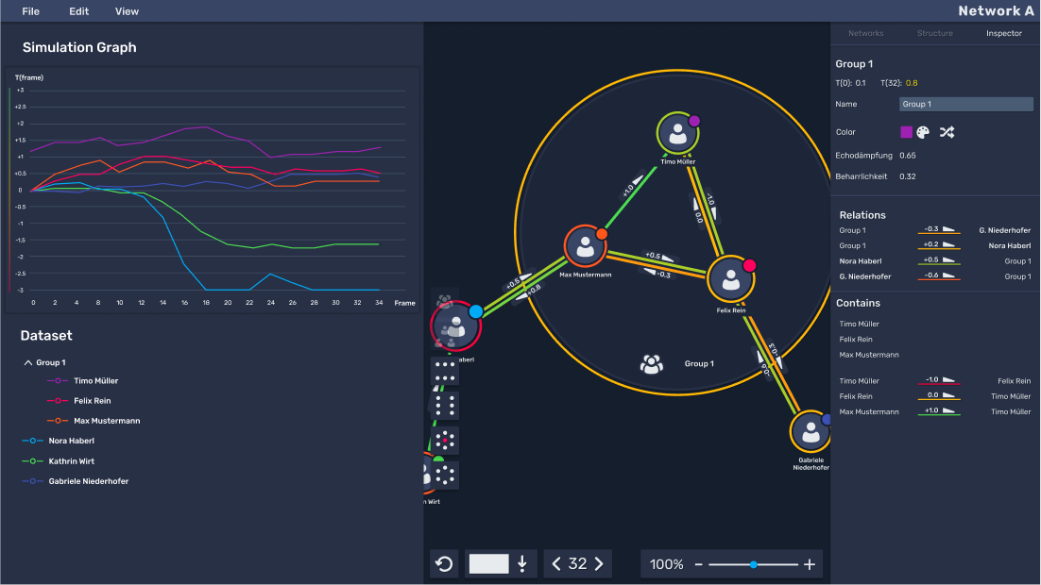
Frontend Prototype

Slide 11
Backend

Slide 12
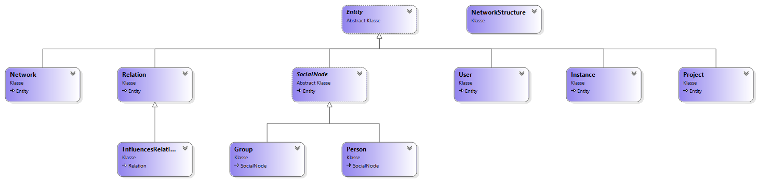
Models

Slide 13
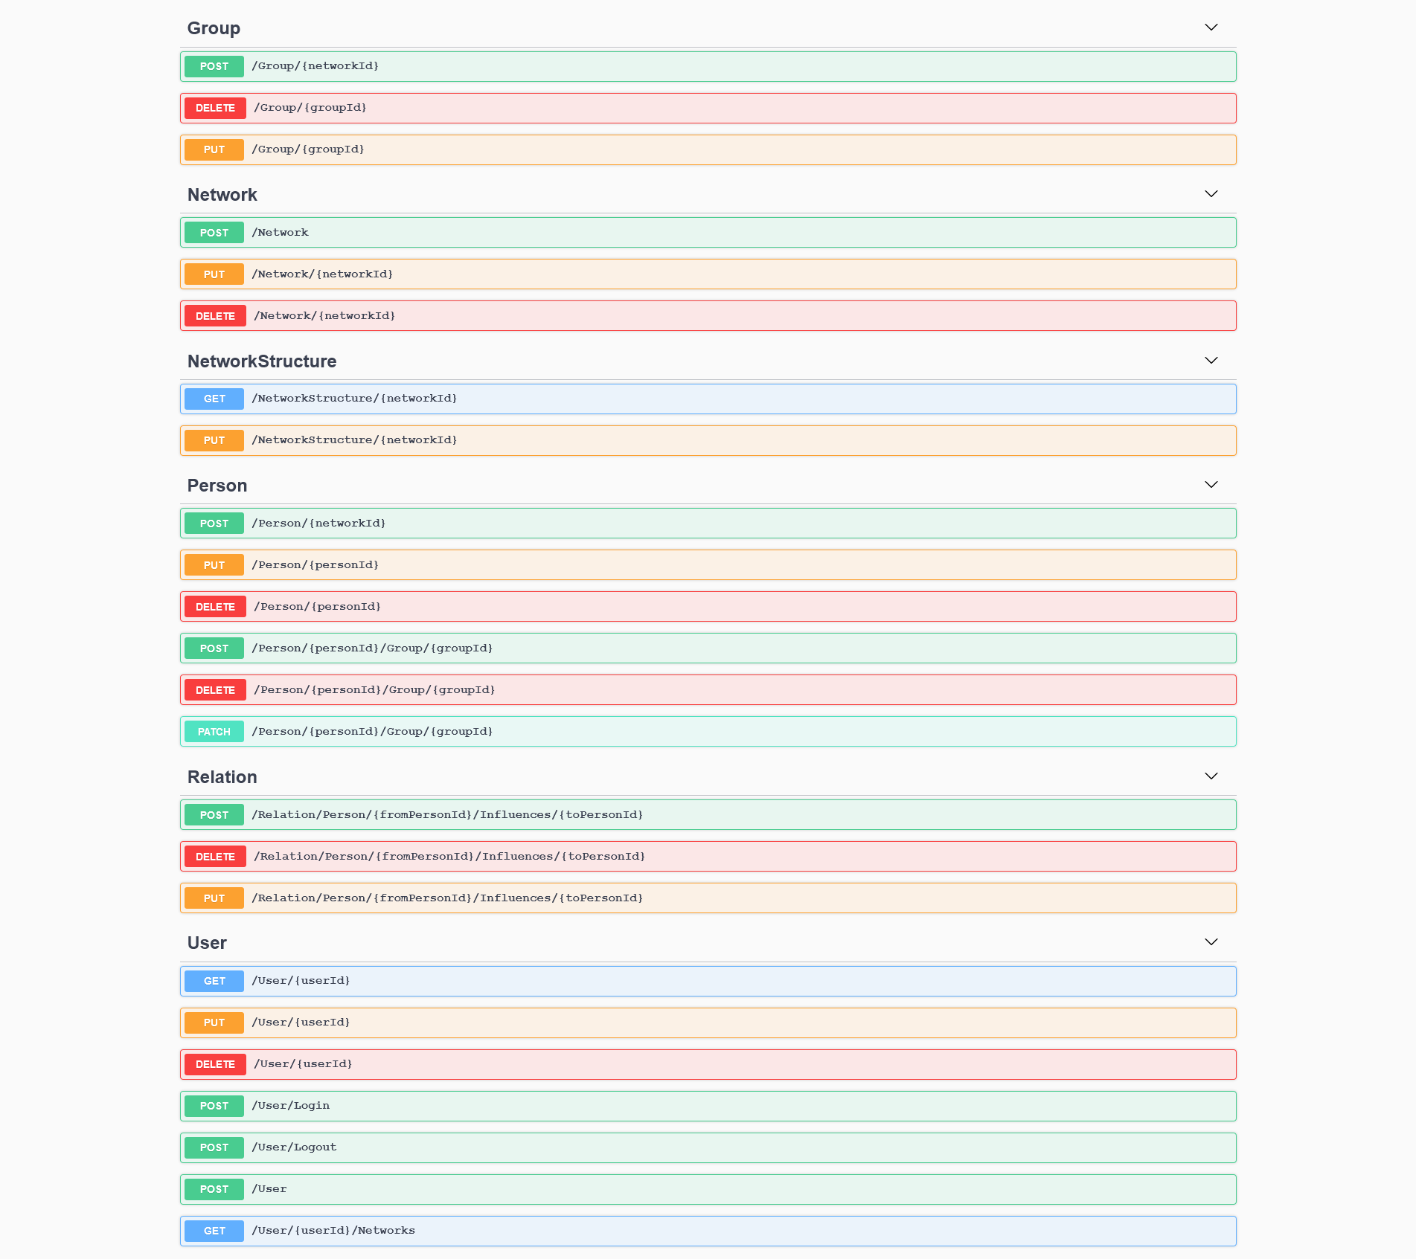
API

Slide 14
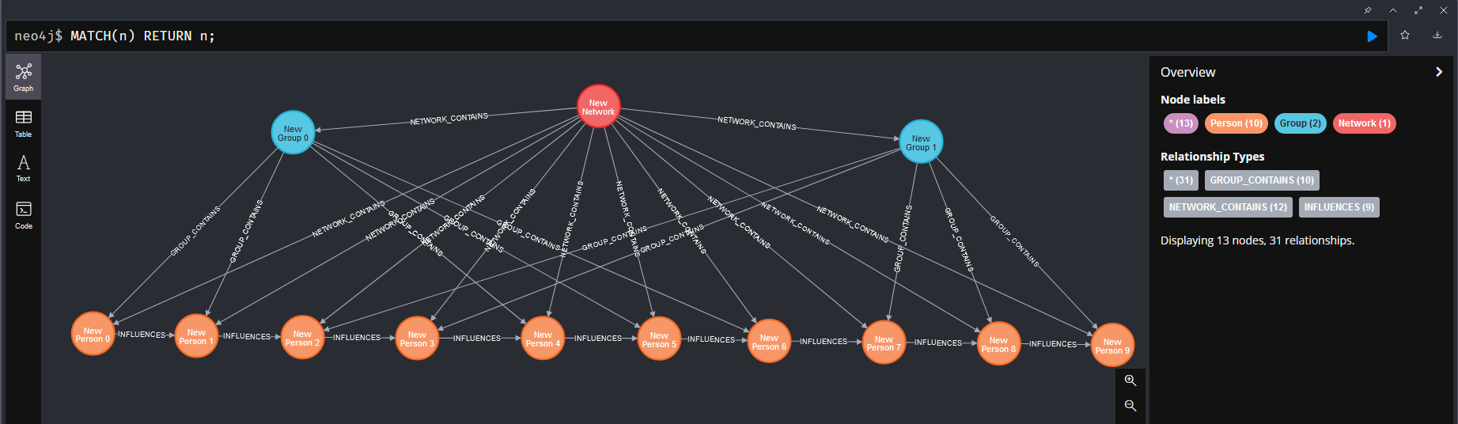
Neo4J

Slide 15
3
Current Status

Slide 16
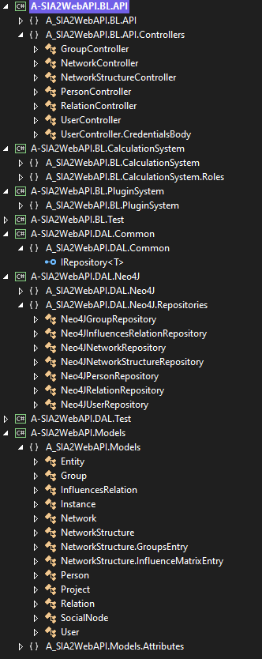
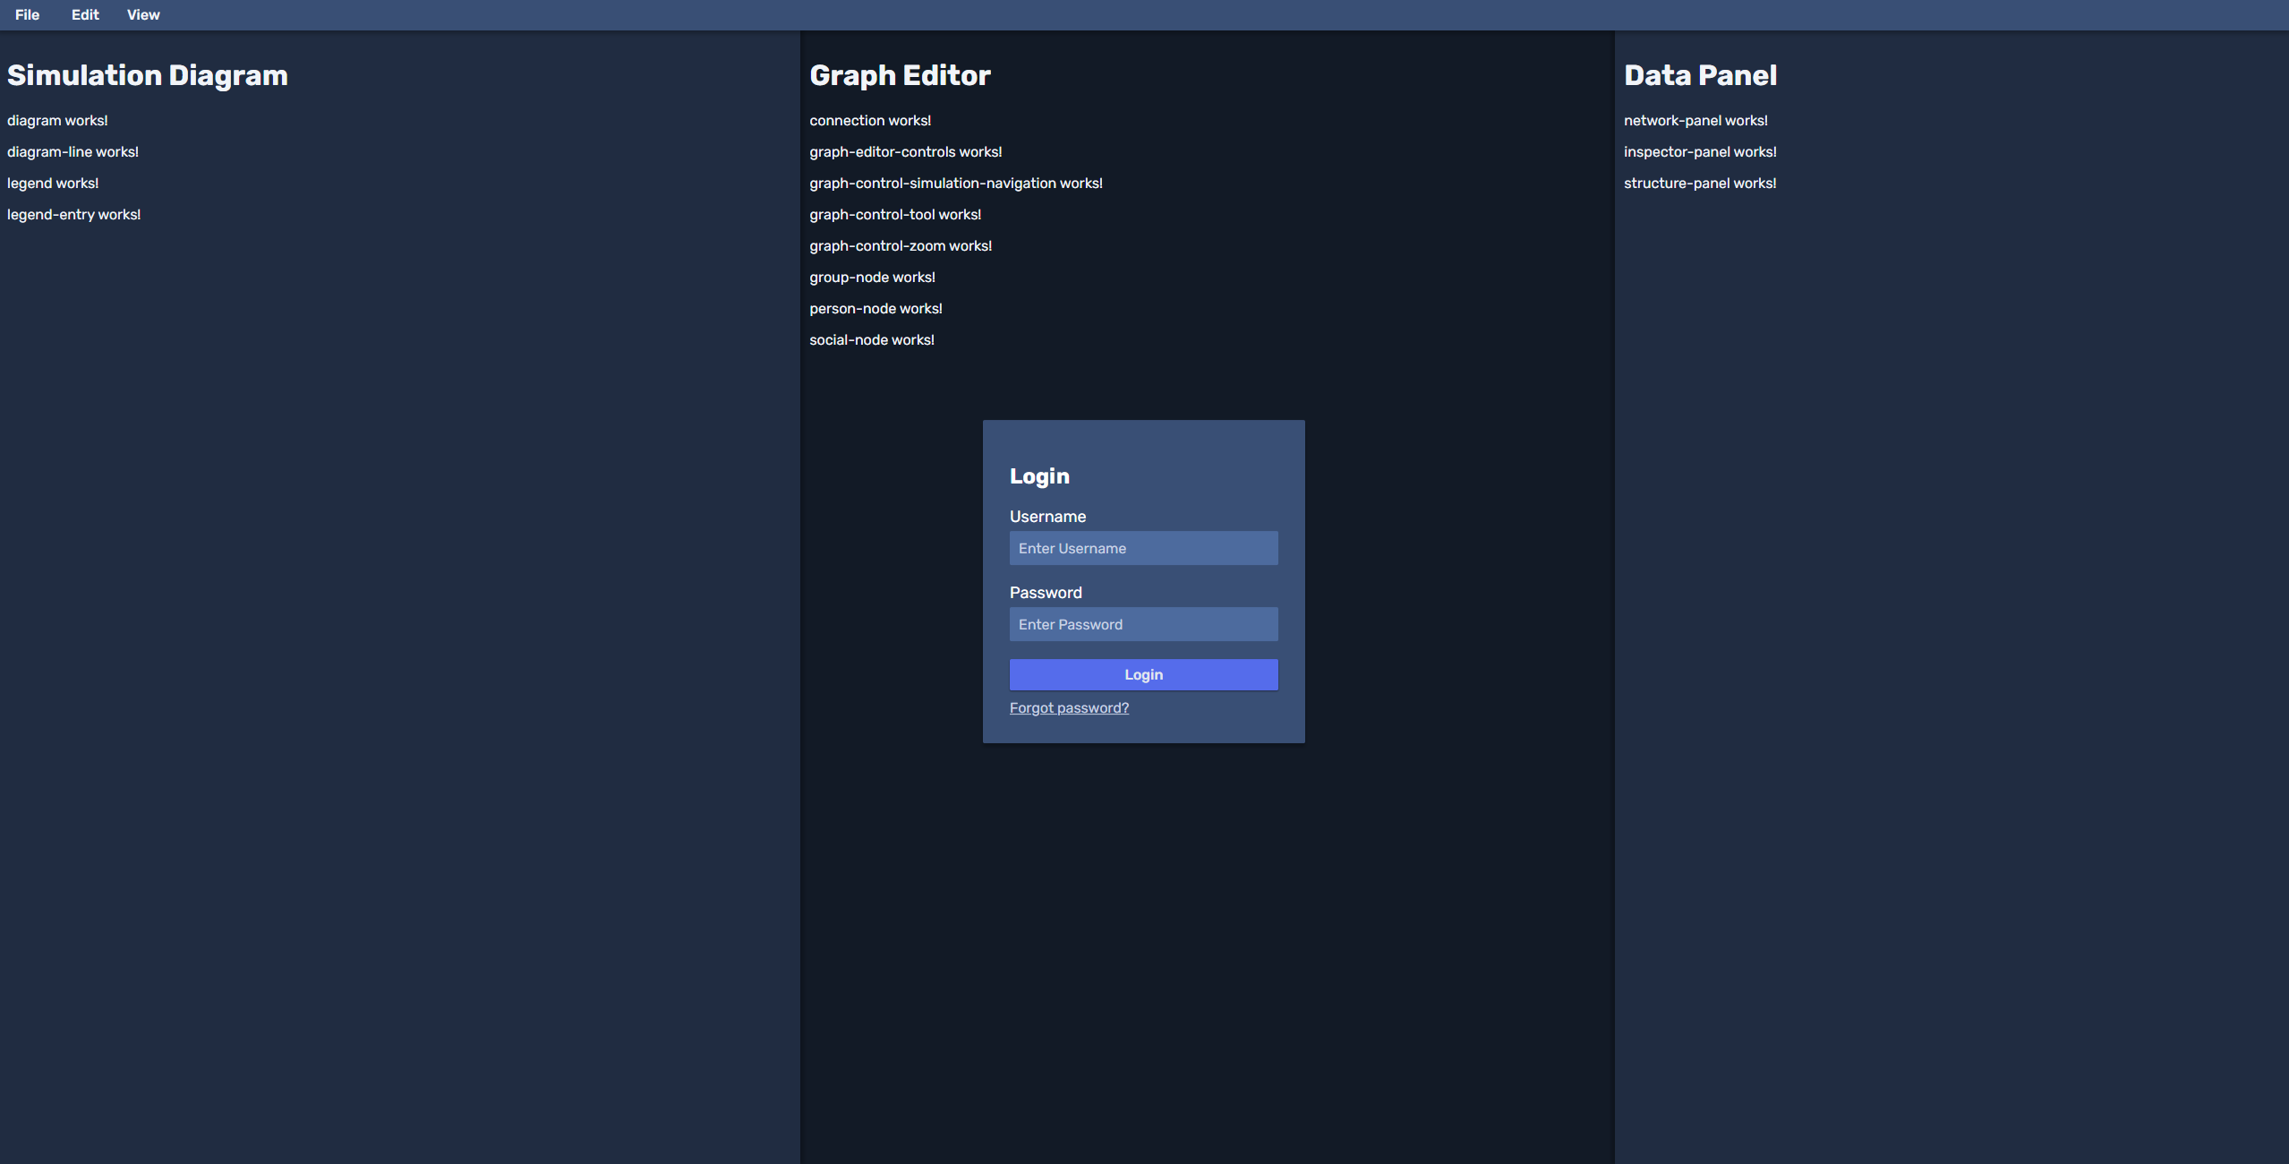
Status

Slide 17
Features
Menubar
Sidebar
Graph Editor
Build network from external data
Generate a report
Simulation Diagram

Slide 18
4
Future

Slide 19

Next Steps
Parallel work on frontend user stories
Read about calculation process
Plan calculation system and data management

